Slide 1
Book of Daniel
Class 3 – Chapter 2
Winter 2023
Why were they allowed to be taken first?
What kind of person is Nebuchadnezzar from chapter 1?

Slide 2
Daniel – Rough Outline
Style
Ch 1-6: Story
Ch 7-13: Vision
2. The King’s Dream
7. Daniel’s Dream
3. The Fiery Furnace
6. The Lion’s Den
4. Nebuchadnezzar’s Pride
5. Belshazzar’s Pride
8. Daniel’s 2nd Vision
1. Recruited to Serve in Babylon
9. Daniel’s Prayer
10-12. Daniel’s 3rd Vision
HEBREW
ARAMAIC
HEBREW

Slide 3
Foreign Authorities
Nebuchadnezzar (605 BC)
  When does he come on the biblical scene? 2 Kings 24
  On what terms do we find Nebuchadnezzar and Judah?
Belshazzar(540 BC?)
  Who was he?
  His “reign” directly predicated what global event?
Darius (521 BC)
  What relation did he have with Nebuchadnezzar?
  What did he do for the Jewish people? Ezra 6
Notes:
Belshazzar was the son and crown prince of Nabonidus, the last king of the Neo-Babylonian Empire. Through his mother, he might have been a grandson of Nebuchadnezzar II, though this is not certain and the claims to kinship with Nebuchadnezzar may have originated from royal propaganda. Wikipedia
Father of Vashti (Queen of Persia – Book of Esther)
King when Babylon fell to Persia

Slide 4
Background and Timing
Timeline of Prophets
  Jeremiah – 626-587 BC
  Habakkuk – 606 BC
  Ezekiel – 592-570 BC
Babylonian Captivity
  1st Wave – 592 BC
  Jerusalem Falls – 586 BC
  2nd Wave – 570 BC
Josiah is restoring worship when Daniel is born (~620)
Daniel lived 620–538 B.C.
Members of Royal Family are carried off to Babylon in 605 B.C. by Nebuchadnezzar, king of Assyria

Slide 5
Daniel 2
Let’s read the text together…

Slide 6
Daniel 2 : 1-18
Debate!
What do we learn about King Nebuchadnezzar by the way he acts in Chapter 2:1-18?
What do we learn about Daniel in Chapter 2: 1-18?

Slide 7
Daniel 2: 1-8
Ungodly Man (King Nebuchadnezzar) | Godly Man (Daniel)
Full of Strife | Bold- Vs. 16 Went to the King
Uncontrolled Anger | Faithful- Vs. 18 Request compassion from the God
Worldly Strong | Strong- Vs. 28 God in Heaven
Selfish and Self- Centered | Fellowship- Vs. 17-18 Friends
Haughty in Spirit | Meek- Vs. 10-23 Praised God
Worldly Wise | Wise- Chapter 2
 | Courageous Vs. 28 God in Heaven

Slide 8
Daniel 2:19-30
Praised God- Vs. 20-23
  How many times do we forget to do this?
Does not take the Praise- Vs. 28
  Are we bold enough to praise God in front of our boss?
Ezekiel 14-12-18

Slide 9
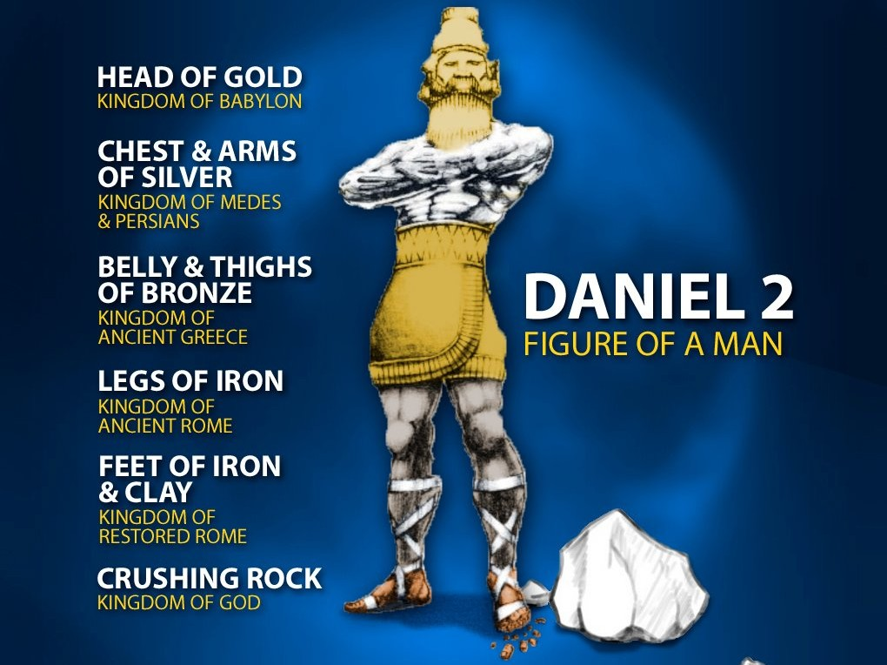
Daniel 2: 31-43

Slide 10
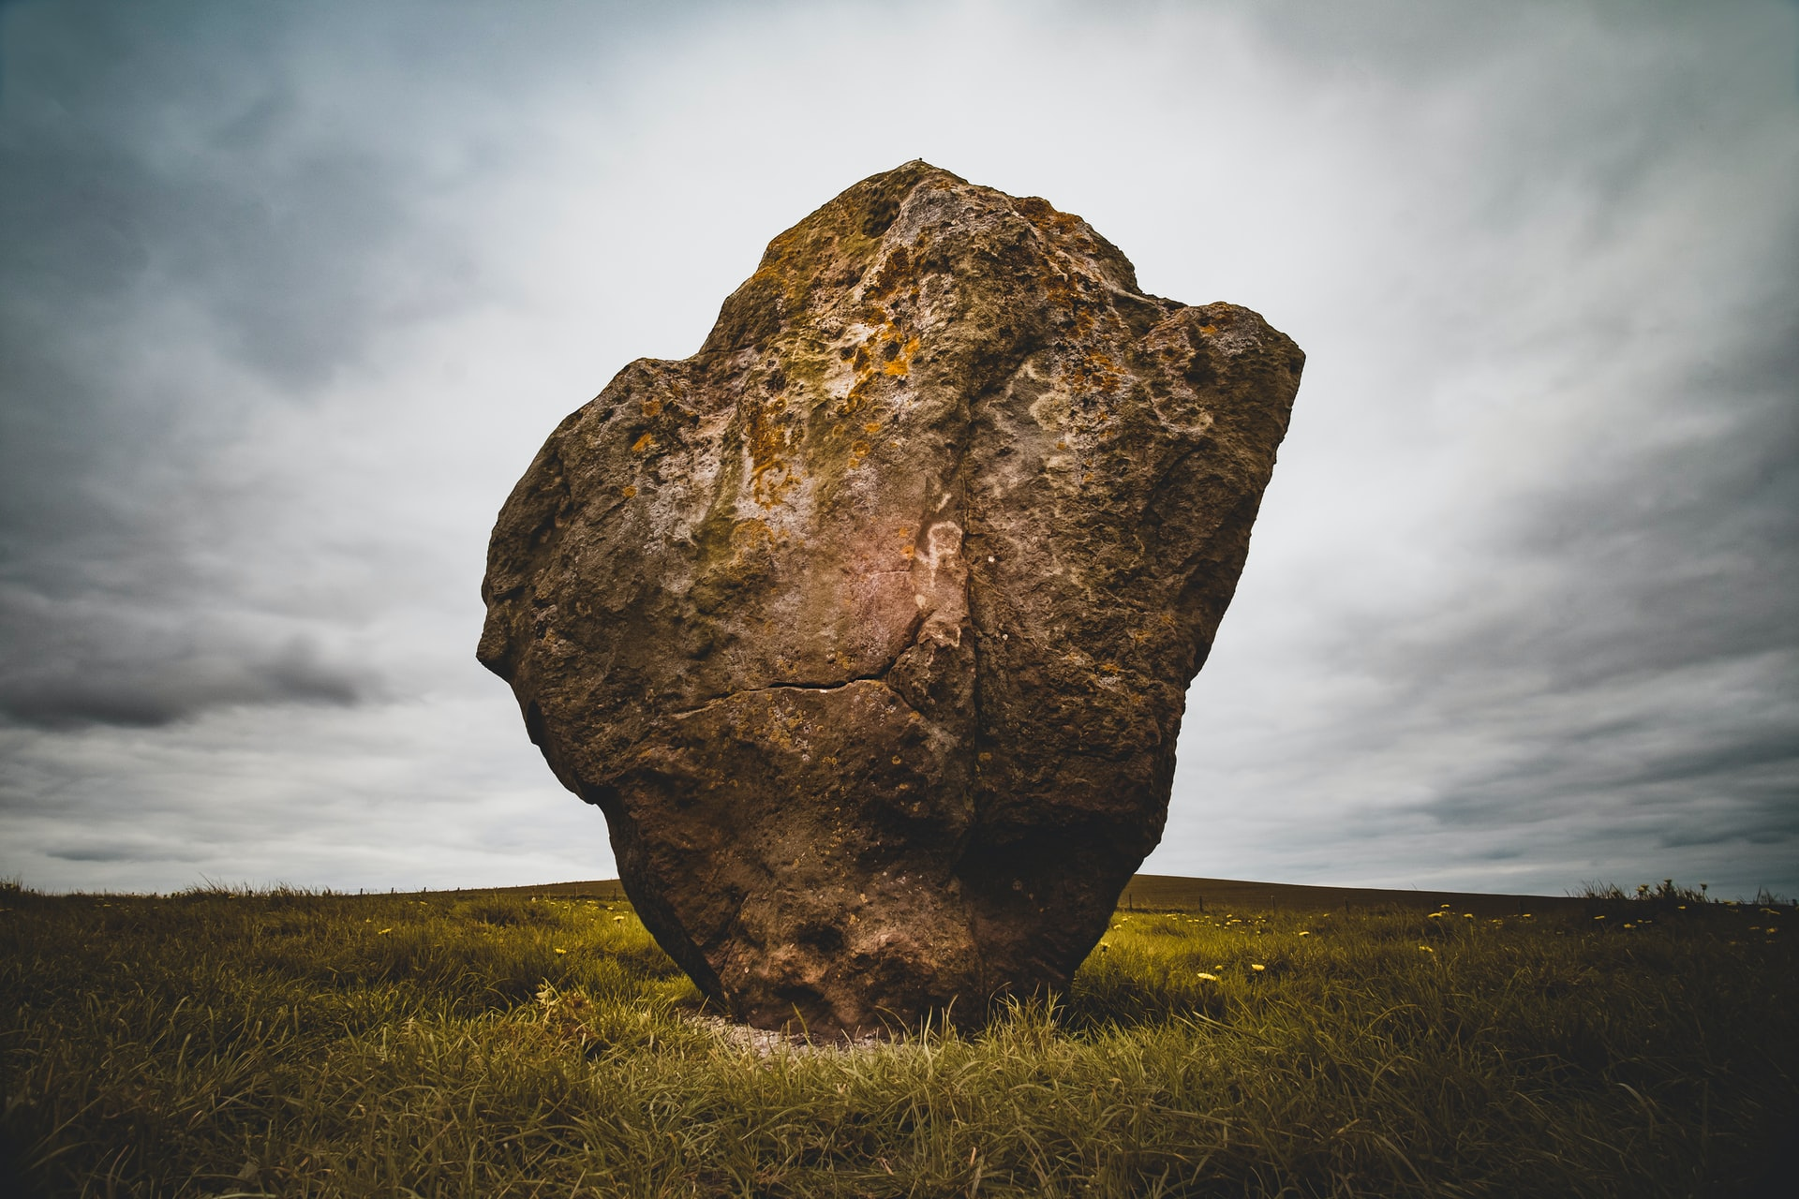
Daniel 2:44-45
The Rock
  Read 44-45
  Matthew 7:24-27- Rock vs. Sand

Slide 11
Daniel 2:46-49
The purpose of Nebuchadnezzar
The purpose of Daniel
The purpose of Babylon’s wise men and on-lookers
The purpose for all today
Daniel Promoted
King Nebuchadnezzar recognizes Daniel’s God
The Purpose of this Story
GOD IS IN CONTROL

Slide 12
The Book of Daniel
Homework: Chapter 3

Slide 13
Daniel: Class Schedule
Date | Class | Teacher
Sun 12/3 | Class Introduction & Background | Robert McDonald
Sun. 12/10 | Chapter 1 | Robert McDonald
Sun. 12/17 | Chapter 2 | H.E. Jenkins
Sun. 12/24 | Chapter 3 | Robert McDonald
Sun. 12/31 | Chapter 4 | H.E. Jenkins
Sun. 1/7 | Chapter 5 | H.E. Jenkins
Sun. 1/14 | Chapter 6 | Robert McDonald
Sun. 1/21 | Chapter 7 | H.E. Jenkins
Sun 1/28 | Chapter 8 | H.E. Jenkins
Sun. 2/4 | Chapter 9 | Robert McDonald
Sun. 2/11 | Chapter 10-11 | Robert McDonald
Sun. 2/18 | Chapter 12 | H.E. Jenkins
Sun. 2/25 | Summary and Themes | H.E. Jenkins

Slide 14

The Bible Project - Daniel

